Slide 1
Assessing the Impact of Traffic Crashes on Near Freeway Air Quality
TRB Paper Number: 17-01567
Monday, Jan 09, 2016 3:45PM 5:30PM, Hall E (D201) / Convention Center
Shinhye Joo, Ph.D Student Researcher, Department of Transportation Systems Engineering, Hanyang University, Ansan, Korea
Cheol Oh, Ph.D., Associate Professor, Department of Transportation Systems Engineering, Hanyang University, Ansan, Korea
Seolyoung Lee, Ph.D Student Researcher, Department of Transportation Systems Engineering, Hanyang University, Ansan, Korea
Gunwoo Lee, Ph.D., Senior Researcher, Maritime Industry & Logistics Division, Korea Maritime Institute, Seoul, Korea

Slide 2
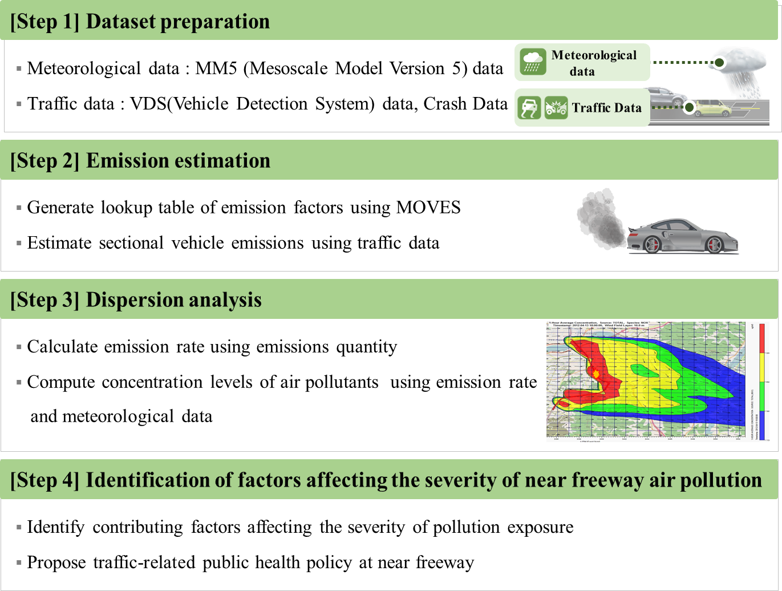
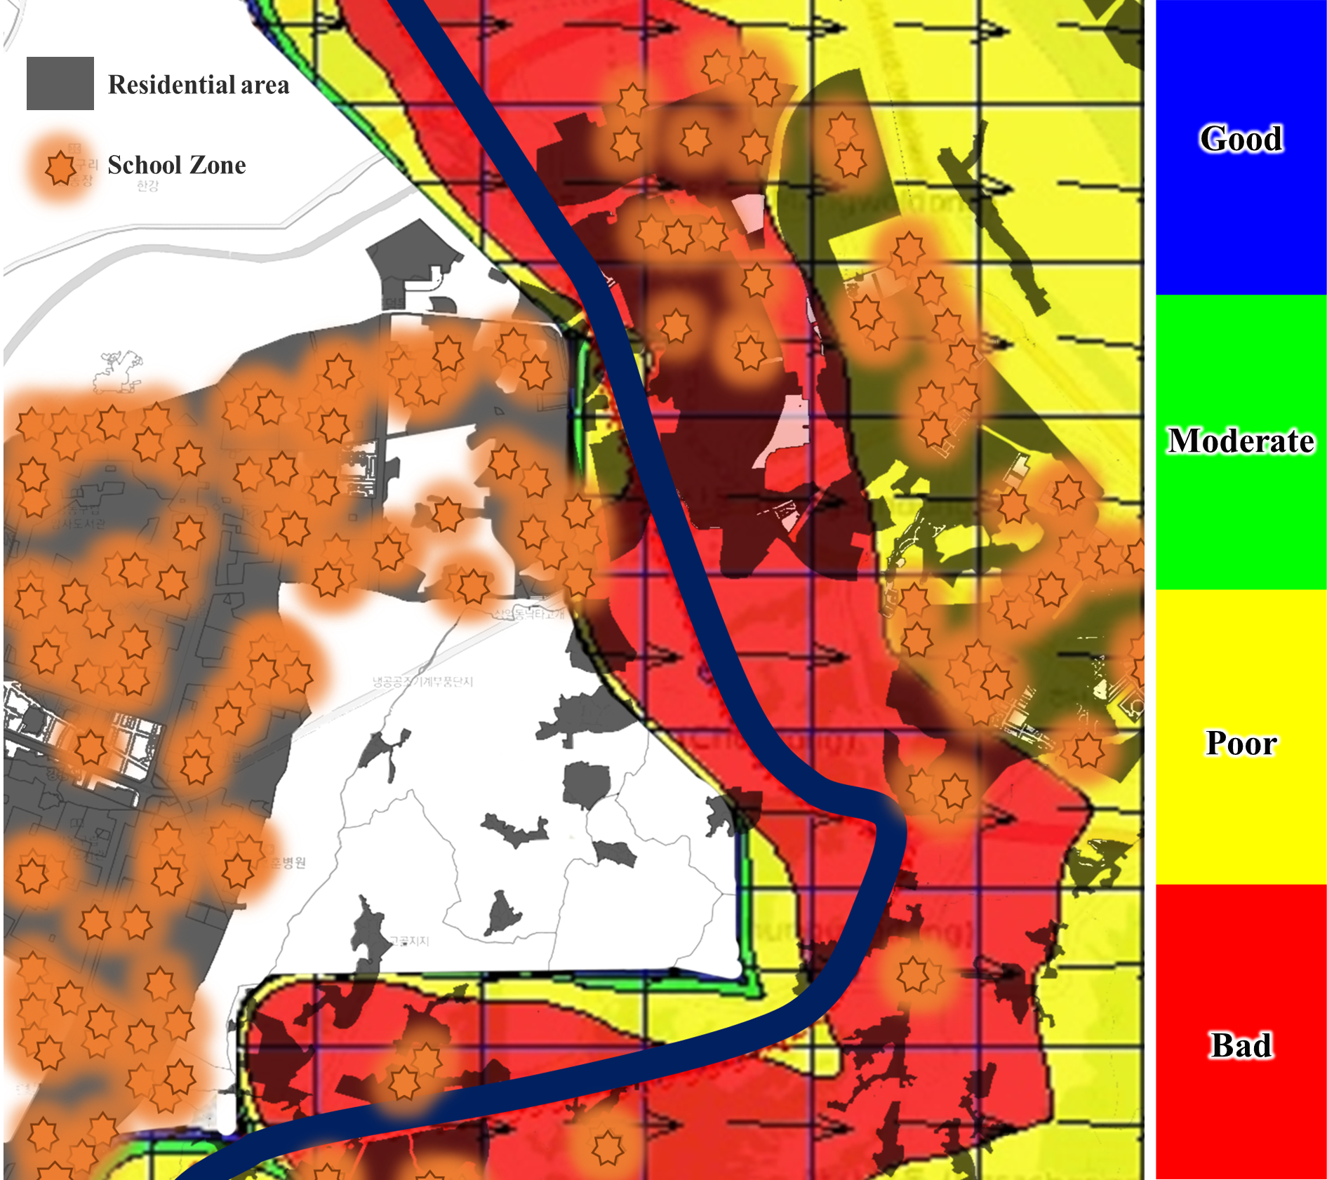
TRB Paper Number: 17-01567
Abstract
A novel feature of this study includes considering crash occurrences when analyzing near-freeway air quality. This study quantifies the impact of traffic crashes on vehicle emissions and the associated near-freeway air quality.
As a result, the local community near freeways within a 1-km radius of crash locations was affected by traffic-related air pollution exposure.
The regression analyses also showed crash characteristics and weather characteristics affect traffic-related air pollution exposure areas.
Finally, this study proposed traffic-related public health strategies to mitigate air pollutants generated from crash occurrences on freeways.
Keywords
Vehicle emissions, Air quality, Traffic crashes, Traffic-related air pollution exposure area, Traffic-related public health

